Slide 1
CO data reduction
Jinghua Yuan (袁敬华, NAOC)

Slide 2
CO demo data and scripts are accessible from the following link.
https://pan.baidu.com/s/1jIlZU4I

Slide 3
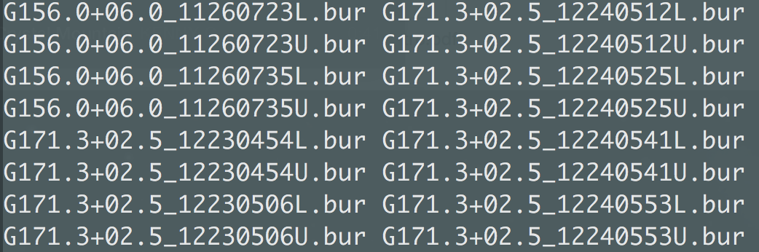
Data for demonstration
Telescope: PMO 13.7 m
Sources: 2 PGCC (G156.0+06.0 and G171.3+02.5)
Observation date: 2011-11-26; 2011-12-24
Lines: J=1-0 of CO, ¹³CO, and C¹⁸O

Slide 4
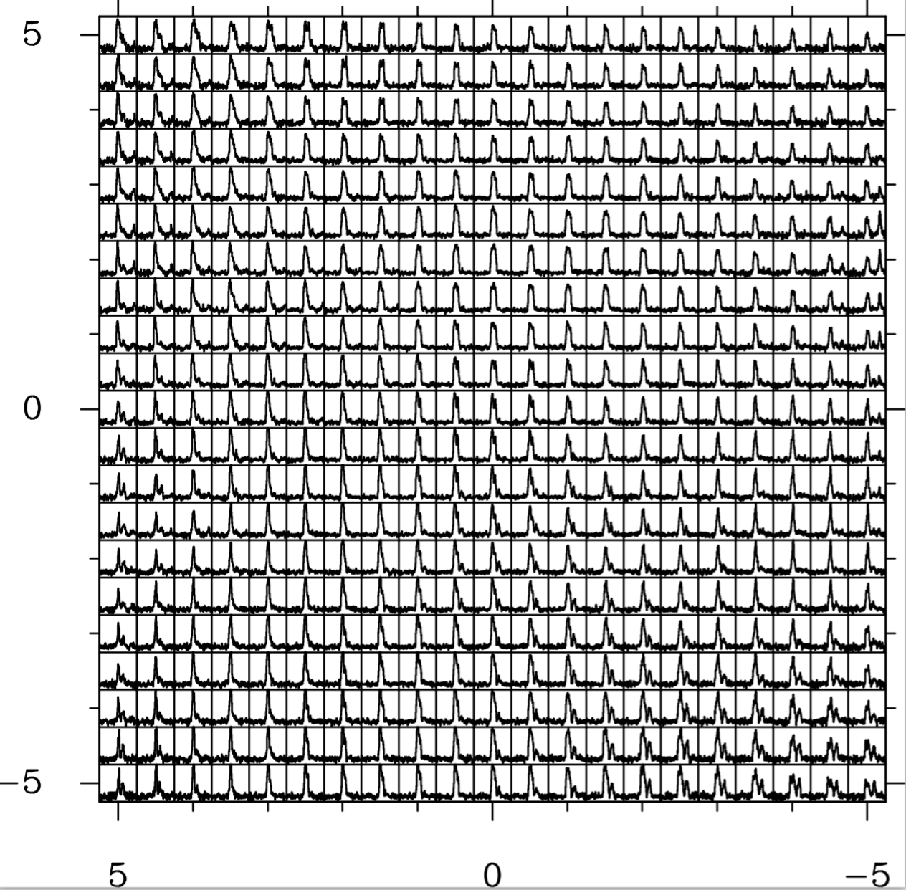
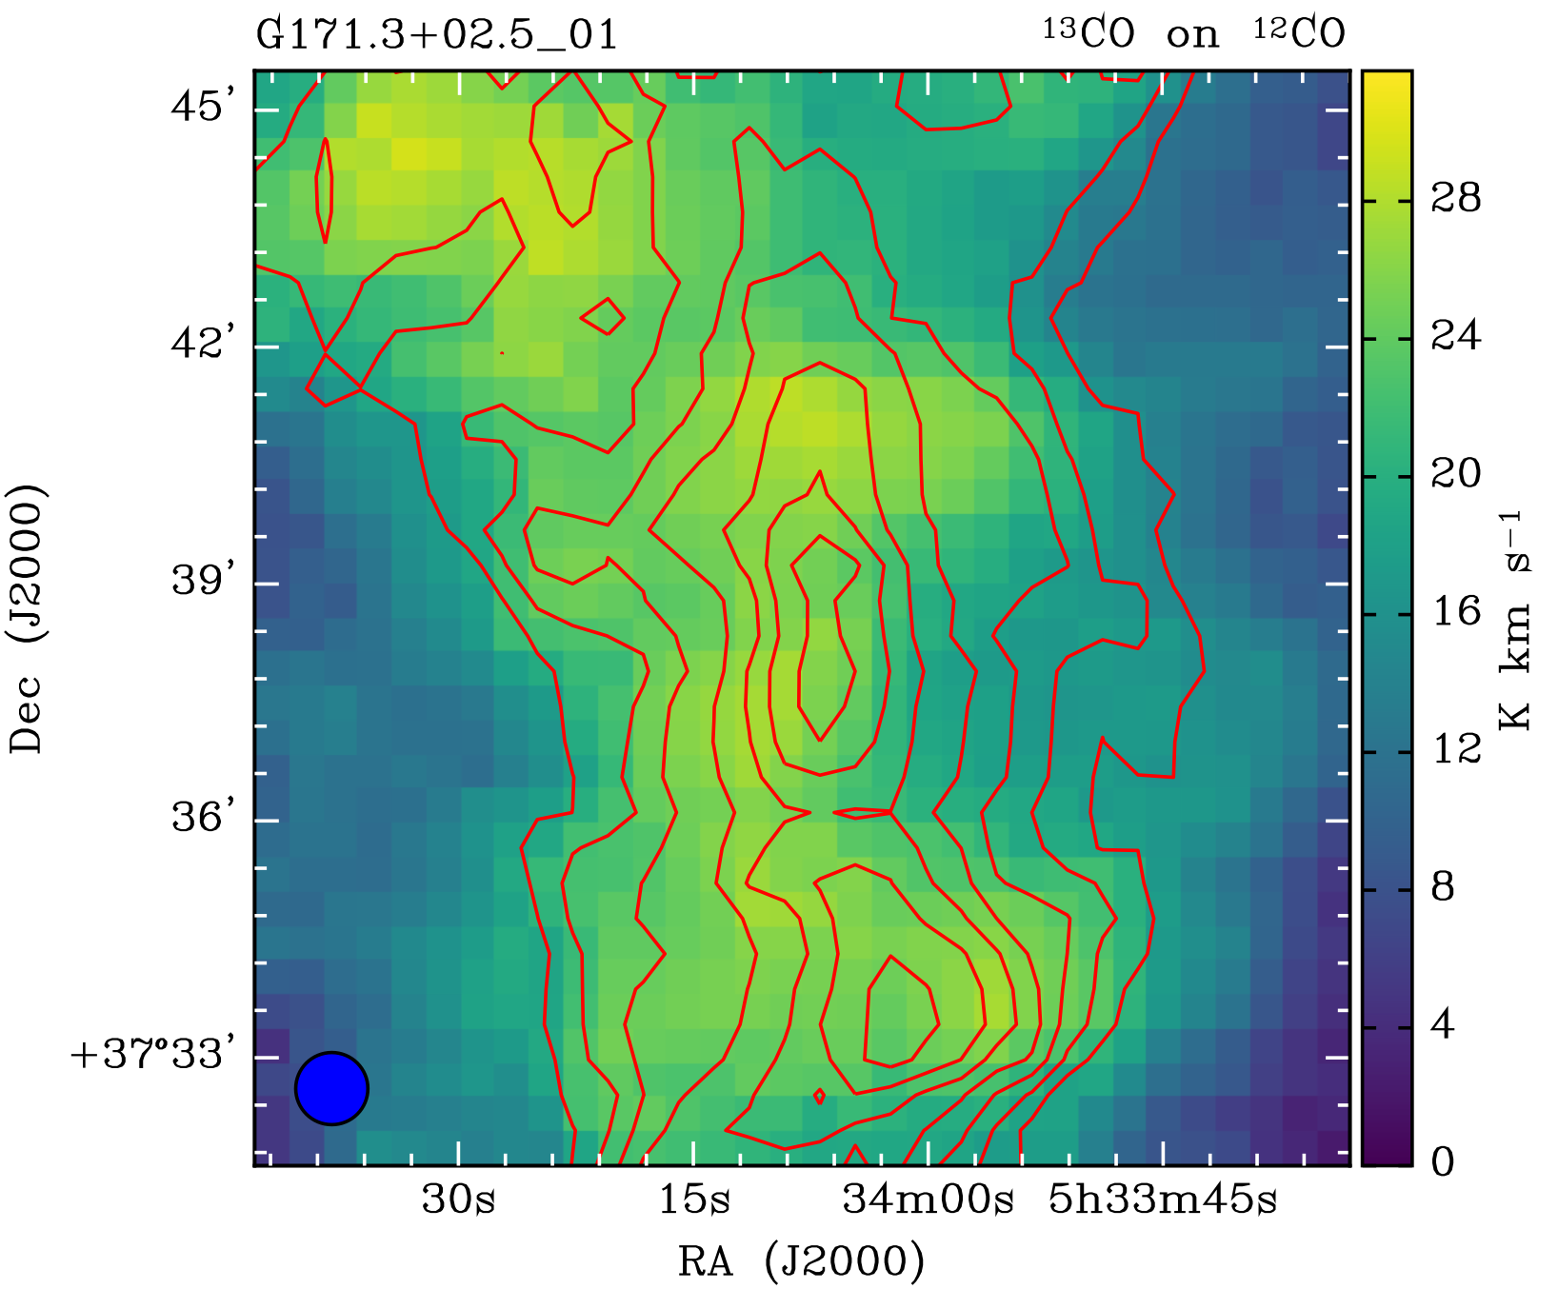
Data for demonstration
GILDAS spectra files
FITS images (N_{H2}, T_{ex}, V_{lsr}, d_{v})

Slide 5
Tools
GILDAS/CLASS
Combine individual observations
Remove baselines
Produce FITS cubes
Python
Velocity integrated intensity maps
N_{H2} and T_{ex} maps
Velocity distributions and velocity dispersions

Slide 6
GILDAS/CLASS basics
Some useful information:
Download and documentation
http://www.iram.fr/IRAMFR/GILDAS/
A short tutorial in Chinese
http://www.radioast.csdb.cn/tools.php
CLASS tutorial by Jerome Pety (IRAM)
http://www.iram.es/IRAMES/events/summerschool2015/presentations/pety-bardeau-gratier-class-tutorial-ss15.pdf

Slide 7
Python dependencies
numpy, matplotlib, astropy, spectral-cube, aplpy
Aanconda distribution
https://www.continuum.io/downloads
Install packages
pip install package-name
Some python tutorials for beginners
A Byte of Python: https://python.swaroopch.com
Python4astronomers: http://python4astronomers.github.io
Astropy Tutorials: http://www.astropy.org/astropy-tutorials/

Slide 8
A brief workflow
Combine individual observations
fit and remove baselines
Convert GILDAS files to FITS cubes
Update FITS header
Produce moment 0, 1, 2 maps
Produce N_{H2} and T_{ex} maps
in GILDAS/CLASS
in python

Slide 9
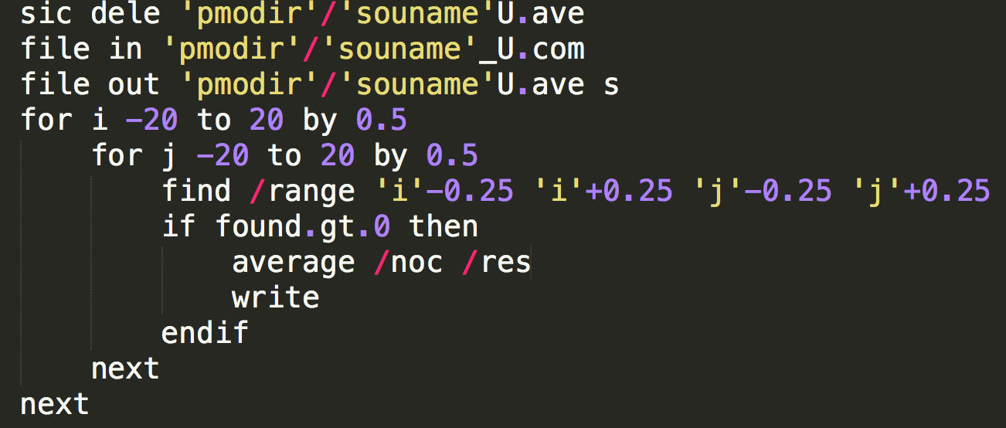
Combine individual observations
CLASS scripts: 001_Combine.class & 002_average.class

Slide 10
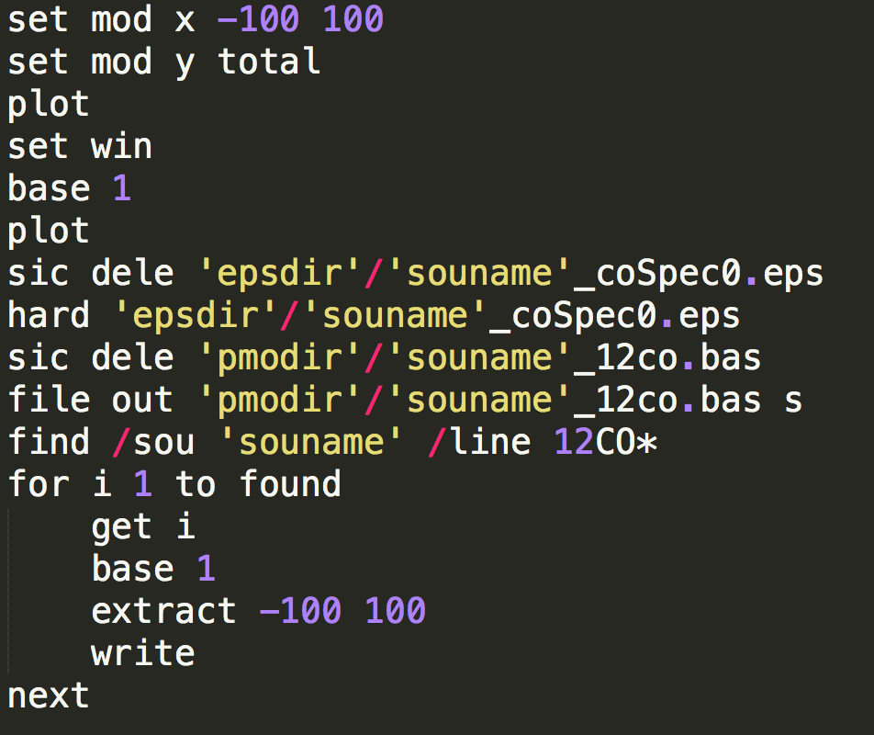
Baseline fitting and removal
CLASS script: 003_sort.class

Slide 11
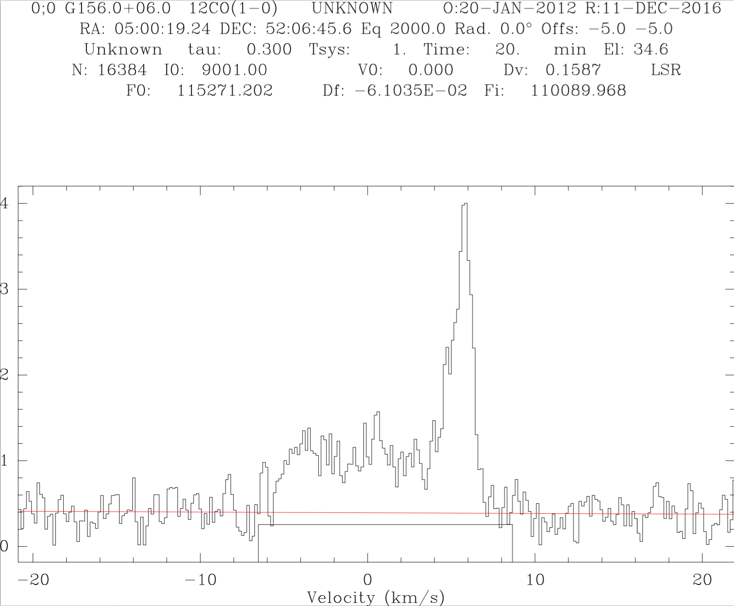

Slide 12
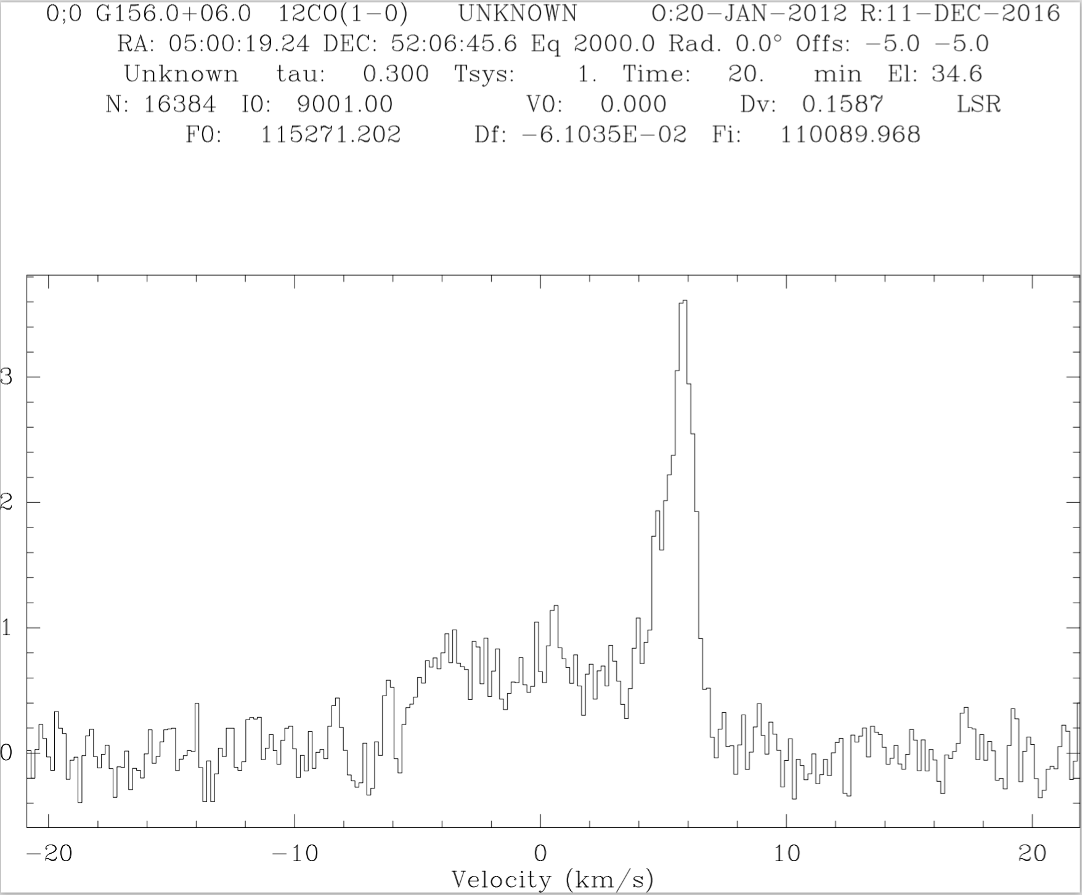

Slide 13
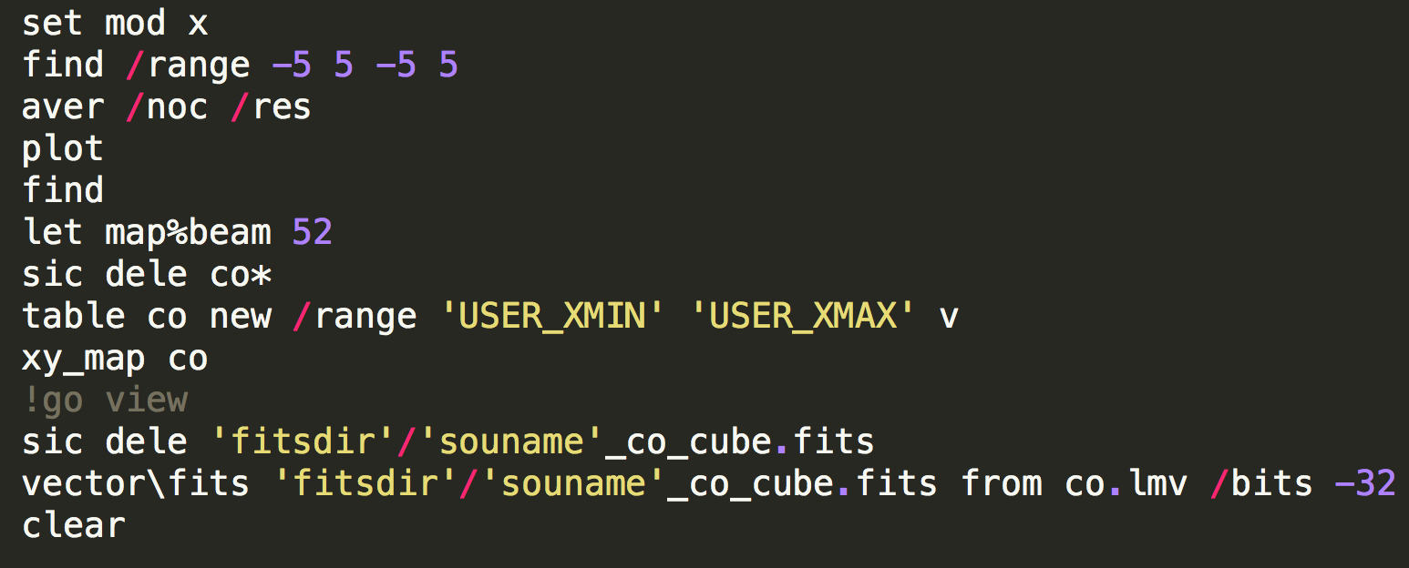
From GILDAS format to FITS cube
CLASS script: 004_gildas2fits.class

Slide 14
From GILDAS format to FITS cube
CLASS script: 004_gildas2fits.class

Slide 15
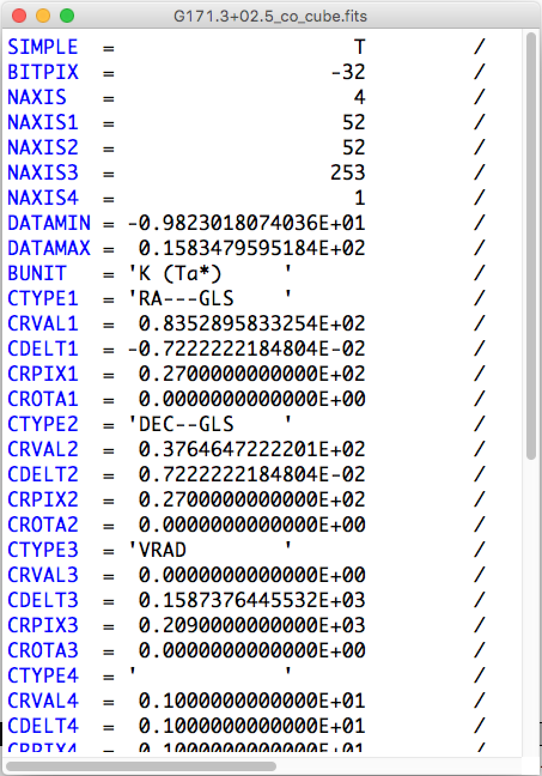
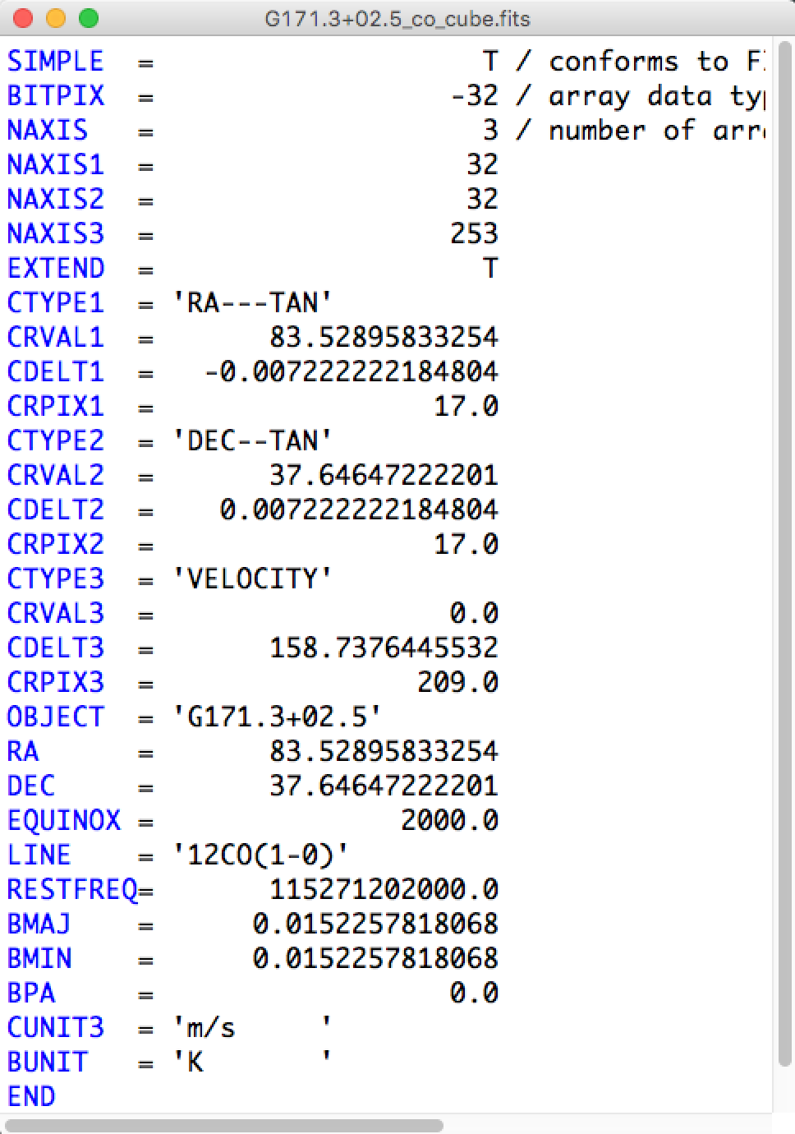
Update FITS header

Slide 16
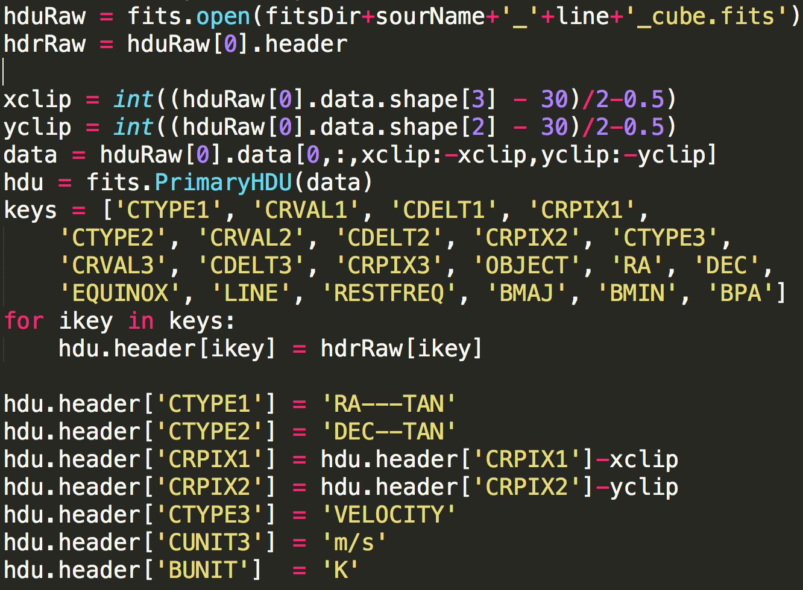
Update FITS header
Python scripts: 005_GildasFITS_header_update.py

Slide 17
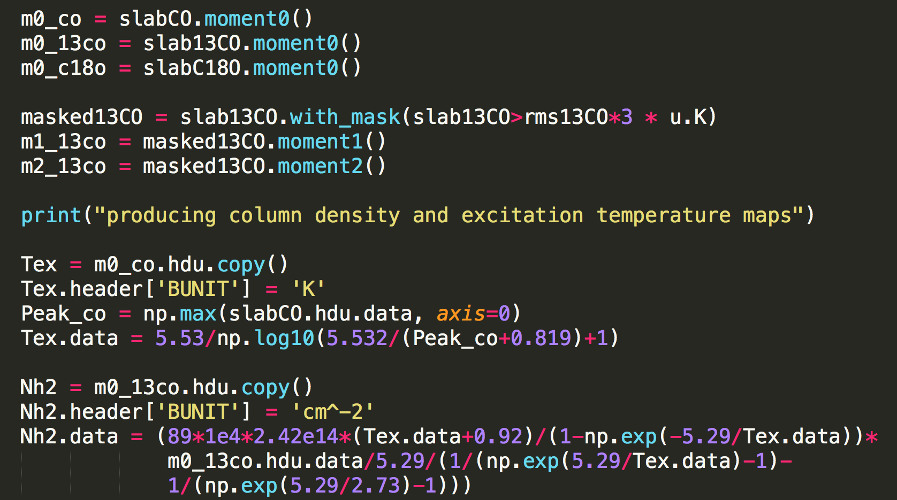
Produce moment 0, 1, 2 maps
Python scripts: 006_images.py

Slide 18



Moment 0, 1, 2
$$M_{0}=∫I dv$$
$$M_{1}=\frac{∫Ivdv}{M_{0}}$$
$$M_{2}=\sqrt{\frac{∫I{\left(l−M_{1}\right)}^{2}dv}{M_{0}}}$$

Slide 19
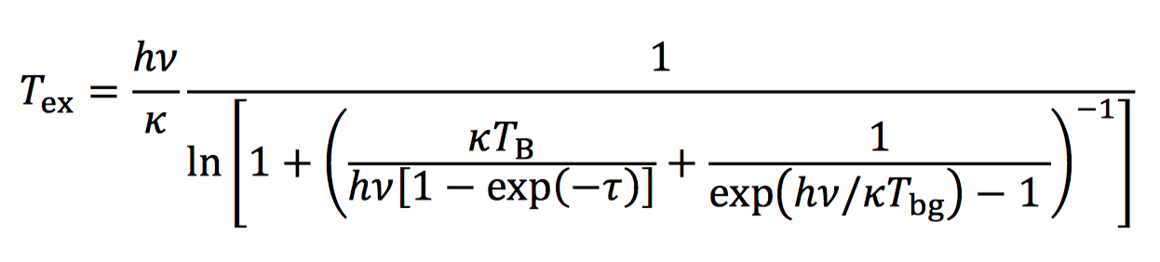
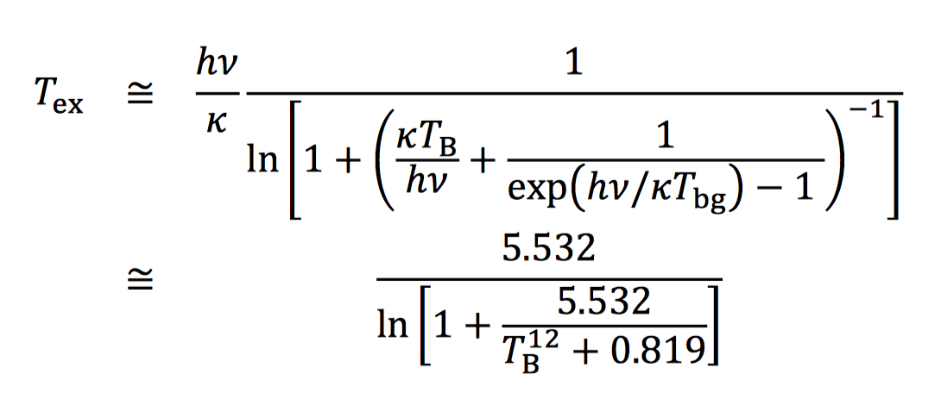
From T_{mb} to T_{ex}
CLASS script: 004_gildas2fits.class

Slide 20
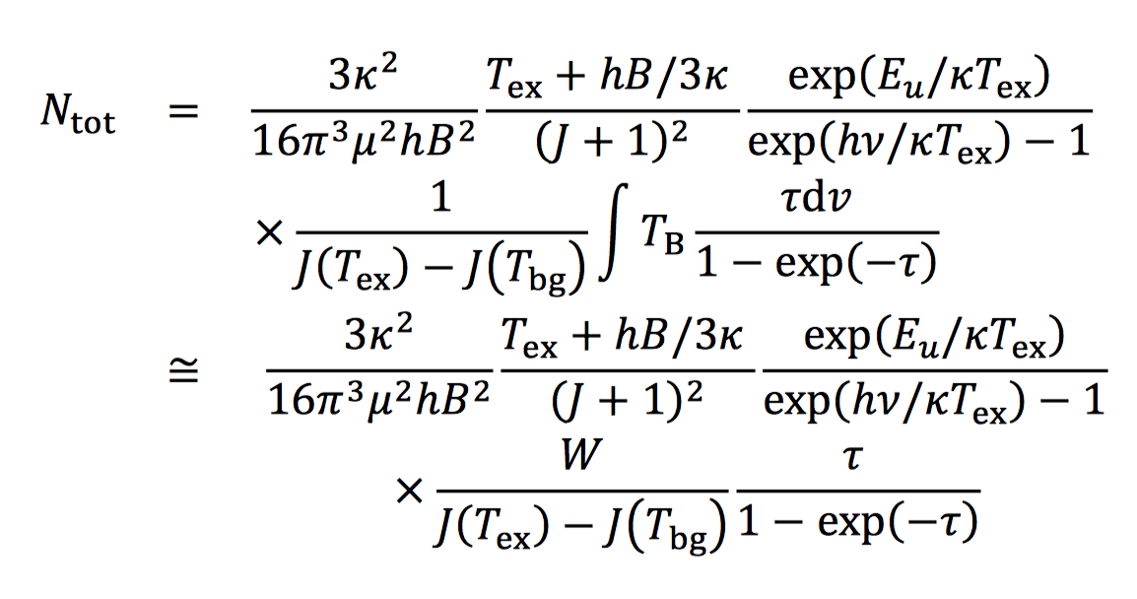
From W(¹³CO) to N_{H2}

Slide 21


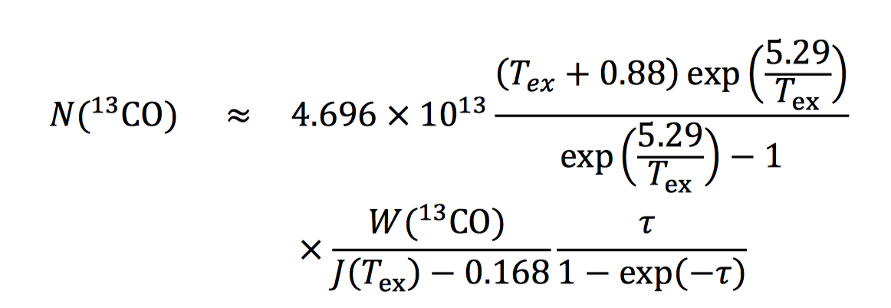
From W(¹³CO) to N_{H2}
For ¹³CO 1-0

Slide 22
use loops to reduce data for
a sample of sources

